Slide 1
Welcome
Instructor: [NAME] Course: [NAME]
Notes:
SCRIPT: Welcome to [COURSE], a[n online class] offered through St. Cloud Technical and Community College. My name is [NAME], and I will be your instructor for this course.
*RECOMMENDED VISUALS: Insert a photo of yourself and any required textbook(s) into the center of this slide.

Slide 2
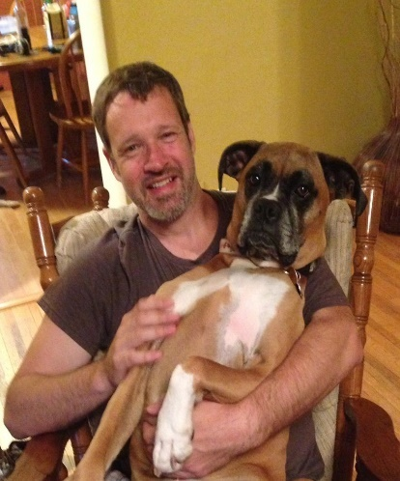
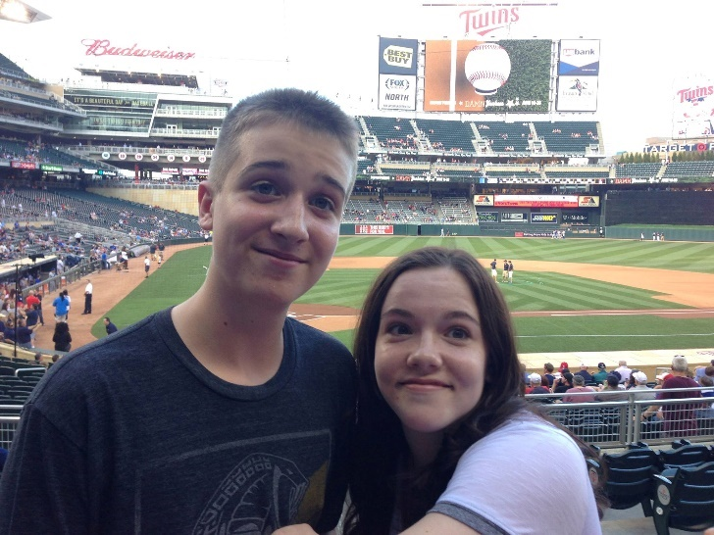
Biographical Information
Work History
Teacher since [YEAR]
SCTCC, [OTHER COLLEGES]
[Other related jobs, if any]
Personal
Live in [CITY]
[FAMILY MAKE-UP, IF COMFORTABLE SHARING]
Interests
Notes:
SCRIPT: Briefly (one minute or less) share your biographical information.
*RECOMMENDED VISUALS: Insert photos of yourself and your family outside of work, if you’re comfortable doing so. Otherwise, put photos representative of the subject you’re teaching and your interests.

Slide 3
Course Overview
[MAIN LEARNING]
[SECONDARY]
[TERTIARY]
[QUATERNARY]
Notes:
SCRIPT: This course focuses on [THE MAIN COURSE FOCUSES]. You will spend the semester [MAIN SEMESTER ACTIVITIES] -all skills necessary to succeed academically, professionally and personally.
The capstone of your semester will be [CAPSTONE PROJECT OR TEST], but don’t worry—by the time we get to that part of the semester, you’ll already have the skills and much of the actual research completed, so it’ll be a piece of cake.
*RECOMMENDED VISUALS: Replace the “writing” image with an image relevant to the course.

Slide 4
Advice #1
It may take a while to get comfortable with the online format
You’ll get more comfortable as the semester goes on
Relax and enjoy yourself
Notes:
SCRIPT: There are a few things you ought to know right up front:
FIRST: If this is your first online course, expect it to take a while to figure out how things work. Until you get the hang of it, you might be a bit frustrated, but you’ll feel a lot more comfortable as the semester goes on. Relax, breathe, and enjoy the experience. If you’re a seasoned D2L user, please bear with me through this presentation. There will be a few things that are new to you and that I would like you to know about the course.
I am regularly available to answer questions and help you through email or via a Zoom call.

Slide 5
Advice #2
Start the course immediately:
Read the entire syllabus
Review [OPTIONAL: AND PRINT] the course calendar
Obtain the required textbooks
Notes:
SCRIPT
SECOND: Get started on the course immediately. Print and read through the Syllabus. You’ll find it in the [LOCATION] area of the course in D2L. The Syllabus lists the course policies. It also lists the titles of the texts you need. You can purchase or rent the required book(s) from the school bookstore or online.
[OPTIONAL FOR THOSE INSTRUCTORS WHO CREATE A PRINTABLE CALENDAR AS WELL AS USE THE D2L CALENDAR]: You should also sync your phone with the D2L calendar as well as print out a paper copy of the calendar to put near your computer. Make your homework plan each week. In other words, as soon as you complete one week’s work, look ahead to the next week, reading through all the assignment requirements, and block off time to complete them before deadline.
*RECOMMENDED VISUALS: Insert a screenshot of the first page of the syllabus and the first page of the calendar as well as images of the course textbook(s). Consider removing the semester/year from any dated visuals so that you don’t have to re-record this. (If you do need to re-record, note that you can re-record a single slide without having to re-record the entire presentation.)

Slide 6
Advice #3
Set up your SCTCC email account (https://www.sctcc.edu/student-email); check it daily
Make sure your computer is set up for D2L; https://www.sctcc.edu/d2l-check-your-computer)
Explore the course
Notes:
SCRIPT
THIRD: Set up your SCTCC email account, if you haven’t already, and plan on checking it weekly. The college email is how I will contact you, and it’s also where you’ll receive important messages about financial aid, school closures, support services available to you, etc. If you don’t know how to get into your student email, type the url on the screen into a new browser to be brought to clear instructions.
Once your email is set up and you have a plan for checking it daily, make sure your computer is set up for D2L. Follow the url on the screen for instructions on how to do that. Note that on the same page as the D2L instructions, you’ll find a link to download Microsoft Office for free, if you need it.
Once your SCTCC email is set up and you’ve confirmed your computer is optimized for D2L, explore the course. Poke into all the areas, including COMMUNICATION and CONTENT. If you encounter any D2L or computer problems now or at any point while a student at SCTCC, contact the STUDENT HELPDESK. Their phone number, email address, and room number are on this slide or can be found on the SCTCC website or in D2L.
If you have any course-specific questions, email me immediately. [OPTIONAL: I check my email several times a day Monday through Thursday, so you can expect to hear back within 24 hours if you email me these days.]

Slide 7
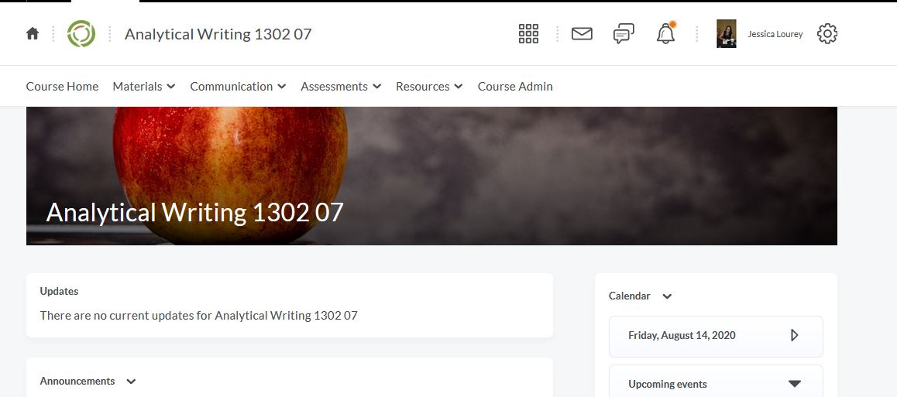
D2L Tutorial
Notes:
SCRIPT
The D2L page you are looking at right now is called the homepage. [OPTIONAL: This is the page you accessed this presentation from.]
You will notice a list of locations right below the name of the course at the top of the homepage: MATERIALS, COMMUNICATION, ASSESSMENTS, AND RESOURCES (you will not have Course Admin in your view). This list of locations is called the navbar, and by clicking into this area, you can access all the information you need to be successful in this course. The Syllabus, all the assignments, and all your grades are accessed through this navigation bar, for example. Explore all of them.
[OPTIONAL: THE TWO AREAS YOU WILL SPEND THE MOST AMOUNT OF TIME IN THIS COURSE ARE…ETC. ETC. IT IS RECOMMENDED YOU CIRCLE ANY KEY AREAS ON YOUR SCREEN AS YOU TALK ABOUT THEM. OPENING THIS PRESENTATION UP IN POWERPOINT AND SELECTING RECORDING>RECORD SLIDE SHOW ALLOWS YOU TO EASILY RECORD SCREEN DRAWINGS WHILE SPEAKING.]
*RECOMMENDED VISUALS: Insert a screenshot of your course instead.

Slide 8
Advice #4
Ask for help when you need it.
Notes:
SCRIPT
MY FOURTH AND FINAL PIECE OF ADVICE: Reach out to me if you find yourself struggling with the material at any point. You’re taking this course to learn, and so you’re certainly not expected to be an expert in anything covered. I can answer your questions, support your learning, and connect you with free tutoring or other support services as needed.

Slide 9
Let’s get started . . .
Go to [LOCATION]
Click on [FIRST THING YOU WANT THEM TO CLICK ON]
Get started!
Notes:
SCRIPT
Your first set of assignments is due before [FIRST DEADLINE], so let’s get started. Go to [LOCATION], make sure to read [OPTIONAL: and print out] the syllabus and calendar, and then move on to Module 1 [LOCATION]. Email me with any questions or concerns! The sooner I know what you need help with, the more support I can provide.
I’m looking forward to working and learning with you this semester.

